Slide 1

Shanmugam Senthil
Principal Group Engineering Manager
Microsoft
Oct 27 2018

Slide 2
Office Apps
Create & co-author documents
SharePoint
Intranets & content management
Azure AD & Office 365 Groups
Identity & Membership
Outlook
Email & calendar
Teams
Hub for teamwork
Microsoft Graph
Search & Intelligence
Office 365 Trust
Security & Compliance
OneDrive
All your files, anywhere
Yammer
Connect across the organization

Slide 3
Opportunity
$1.4 B
Spent by M365 customers on custom solutions
90%
Fortune 500 companies have data in Microsoft Graph
135M
Monthly active users in Office 365

Slide 4

Microsoft 365 Platform
Extend Microsoft 365 experiences
web, device, and service apps
Build your experience
Documents
Pages
Conversations
Timeline
iOS/Android/Windows/Web
1
Microsoft Graph

Slide 5







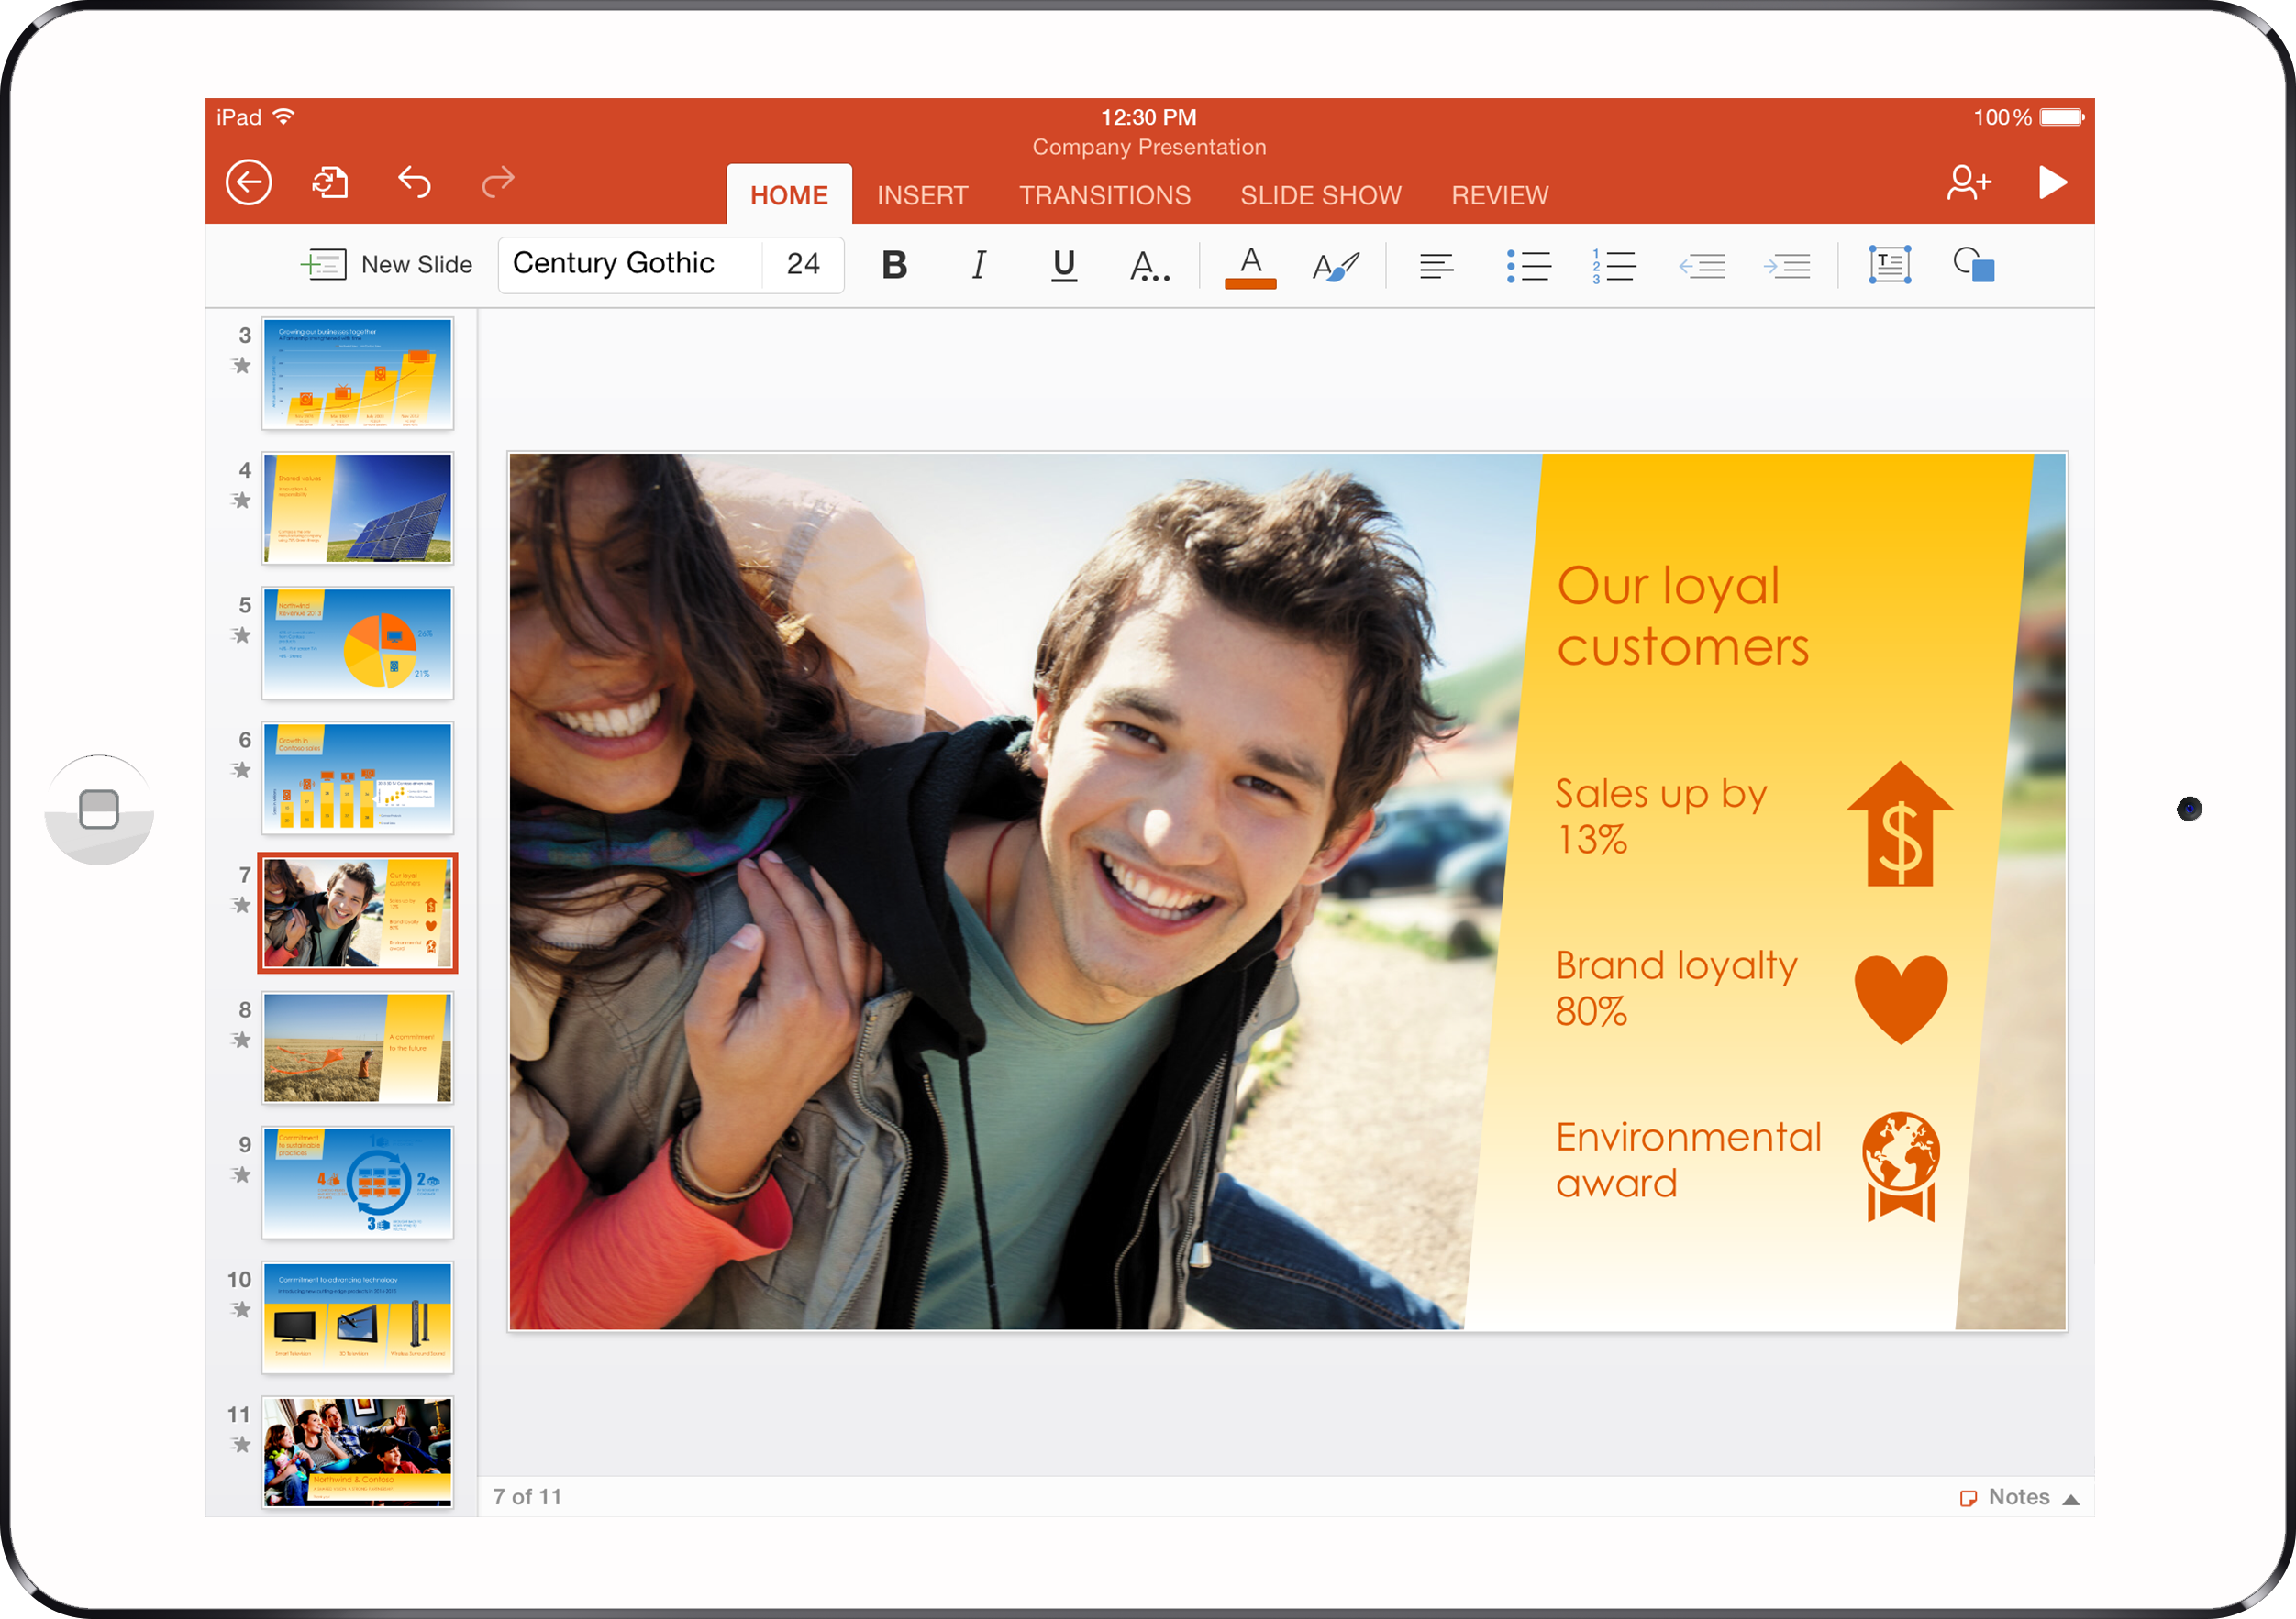

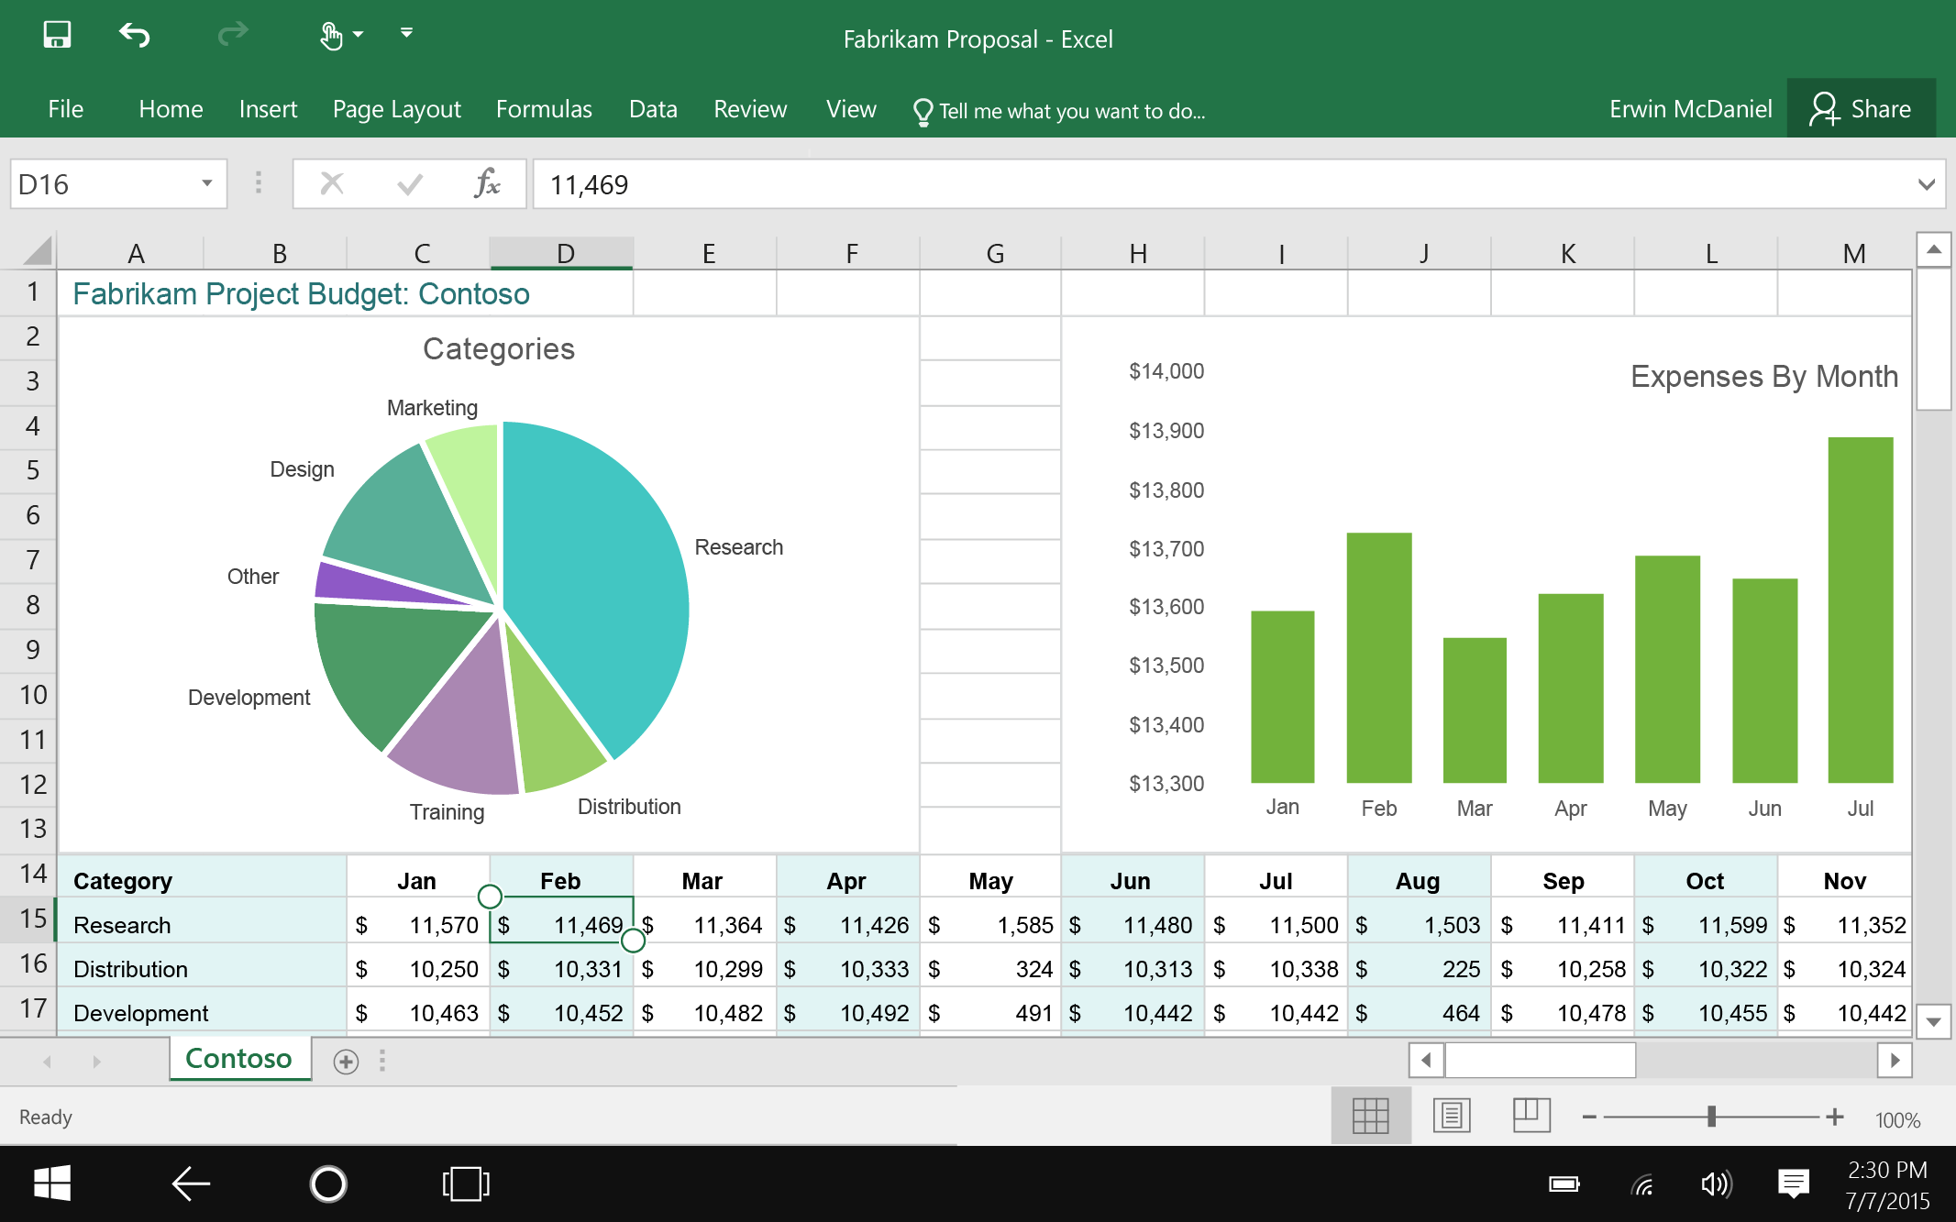
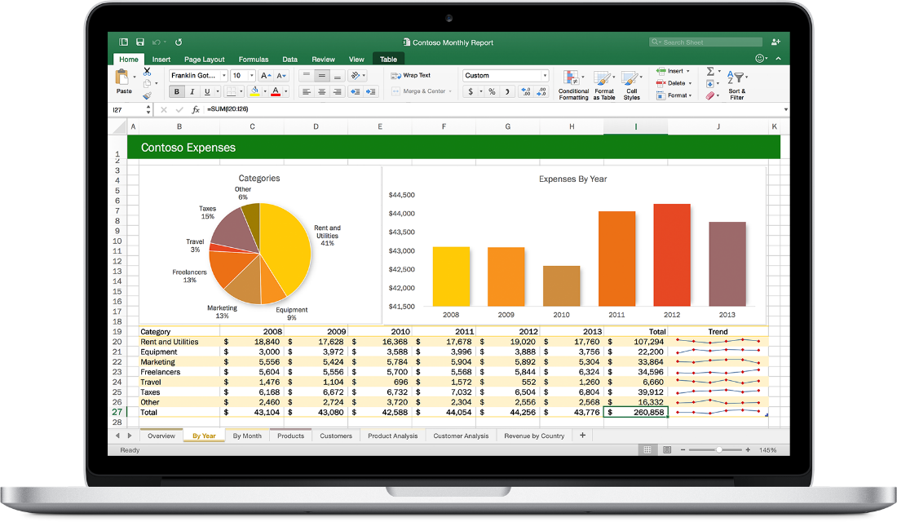


Web technologies
Cross
platform
Make your solution part of Office canvases
Extend Office applications across platforms using web technologies
Modern distribution
Store
Centralized Deployment

Slide 6
Bootcamp Agenda
Addins and Actionable Messages in Outlook | Pankaj Pal
Power of Graph API | Sathish Natarajan
Immersive Experience on Microsoft Teams | Vishrut Shukla
Hands on Labs - Teams Bot | Shantha Kumar & Jayanthi
Secrets to master SharePoint Framework | Shantha Kumar

Slide 7
Teamwork is how work gets done
2x
50%
5x
Teams compared to 5 years ago
Increase in “collaborative” work
More likely to be high performing
Internal & external members People outside the firewall need unfettered access
Geographically distributed Need varied ways to connect across locations and time-zones
Diverse workforce Different expectations, preferences, and tool demands

